Slide 1
Company name: go-bro-project
The capstone contains the network infrastructure plan for one of the company offices.

Slide 2
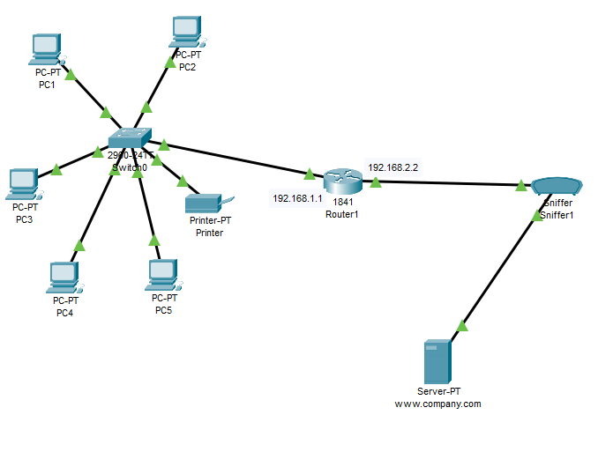
Infrastructure Plan:
5 pcs
1 printers
1 24 ports switch
1 Router
Sniffer
1 Web server

Slide 3
Ip used :
PC1: 192.168.1.11
PC2:192.168.1.12
PC3:192.168.1.13
PC4:192.168.1.14
PC5:192.168.1.15
PRINTER:192.168.1.16
Router Fa0/0: 192.168.1.1
Fa0/1: 192.168.2.2
Web server : Fa0: 192.168.2.3

Slide 4
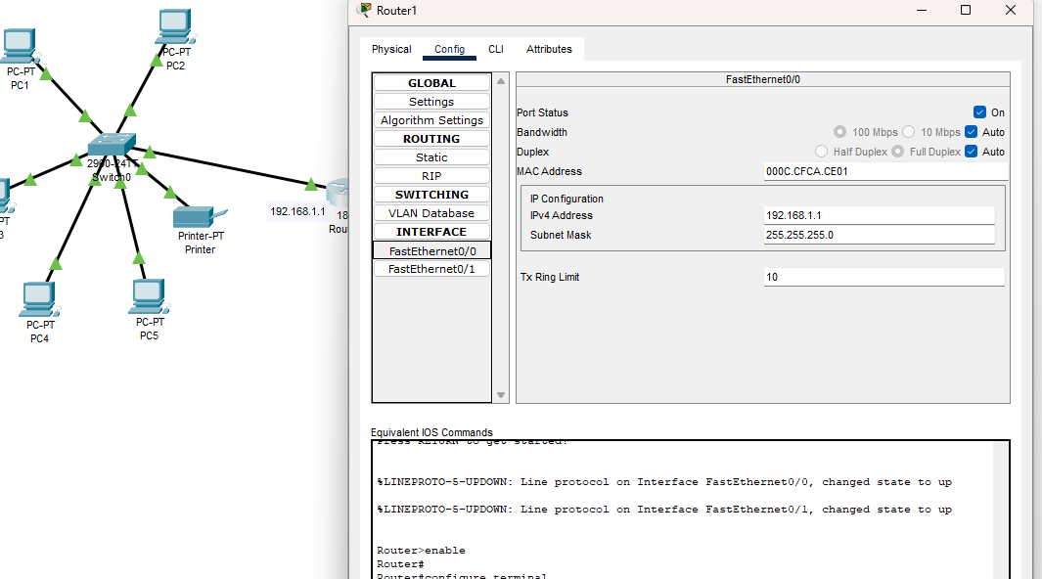
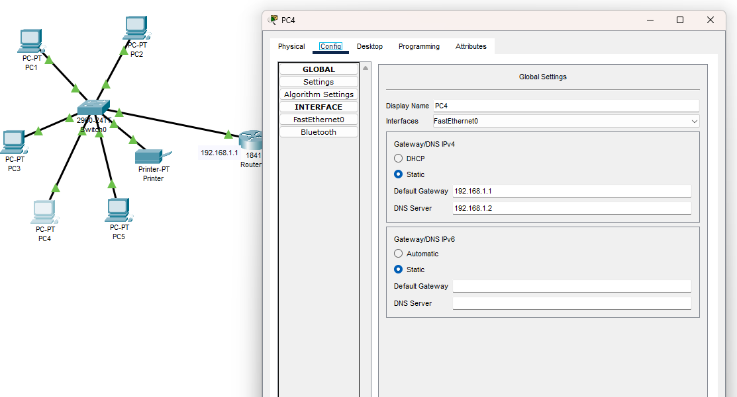
Configuration

Slide 5
Some notes
All pcs and printer are wired connected
Any pc can send and receive from the other and can use the printer
All pcs can contact the web server safely by using Sniffer
The router is the connection between the network and the web server
Everything works properly after testing.

